Slide 1
Delta Packaging Inc.
Stock Product Brochure
CALL FOR SPECIAL SIZE & DESIGNS & PRICING
DELTA PAKAGING INC.
1601 COLMAN AVE
WEST MONROE LA, 71292
318-387-3805 OFFICE

Slide 2
Dear Customer,
We at Delta Packaging Inc. would like to thank you for your interest in our company. We have over 100 years of combined experience in the folding carton business and look forward in developing a long term relationship with you.
Please find in-closed in this packet a list of just some of the stock cartons Delta Packaging produces on a daily basis. Delta Packaging is also capable of producing and printing specialty cartons with your specifications in mind. We have a great design team to help with any carton design you may want Including window bakery cartons.
If you have any questions about our company, or if you would like more information please feel free to contact any of our professional staff at Delta Packaging Inc. Or visit us at www.deltapackaginginc.com. Again we thank you and look forward to becoming a partnership with you and your company.
Thank You
_____________________________
Brice Knight
Sales Manager/Delta Packaging
Office: 318-387-3805
Cell: 318-914-3194

Slide 3
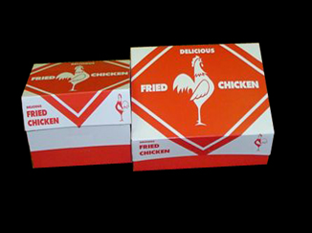
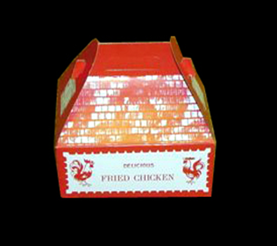
Chicken Boxes
CARRY OUT CHICKEN BOXES
STYLE- SIX CORNER AUTOMATIC
PRINT- ONE COLOR STOCK RED DESIGN
PRODUCT CODE PROD. DESC. CASE PACK CASE WEIGHT
1150 7X5X3 printed 250 18
1151 9X5X3 printed 250 21
1152 9.5X6.5X3 printed 250 28
CARRY OUT BARN CHICKEN BOX
STYLE- FULL AUTOMATIC BOTTOM WITH HANDLE
PRINT- ONE COLOR STOCK RED DESIGN
PRODUCT CODE PROD. DESC. CASE PACK CASE WEIGHT
1155 8.5X5.5X3.5 printed s/barn 250 43
1156 9X6X6.5 printed barn 200 52

Slide 4
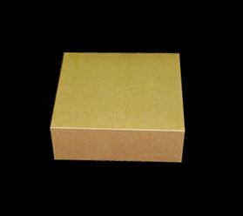
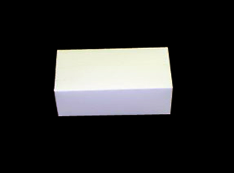
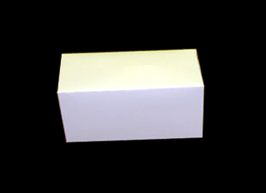
All purpose carry out Boxes
ALL PURPOSE CARRY OUT BOXES
CHICKEN / FISH / BAKERY
STYLE- AUTOMATIC BOTTOM- FAST FOLD TOP( PLAIN WHITE)
PRODUCT CODE PROD. DESC. CASE PACK CASE WEIGHT
1170 (SNACK) 7X4.5X2.75 500 33
1171 (DINNER) 9X5X3 400 39
1172 (FAMILY) 10X6X6 200 33
STYLE- SIX CORNER AUTOMATIC( PLAIN WHITE)
PRODUCT CODE PROD. DESC. CASE PACK CASE WEIGHT
1175 7X5X3 250 18
1176 9X5X3 250 21
1177 9.5X6.5X3 250 28
1180 9x6x6 ½ 250 52
1250 10x7.75x3 200 52
1251 11x9x4 200 55

Slide 5
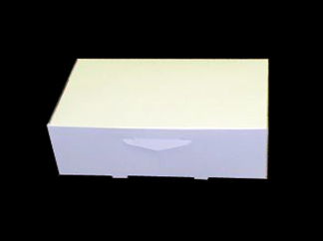
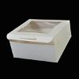
Bakery Boxes
BAKERY BOXES
STYLE- LOCK CORNER (PLAIN WHITE)
also available with windows
PRODUCT CODE PROD. DESC. PACK/BDL BDL WEIGHT
1008 8X8X4 200 42
1009 9X5X4 250 40
1010 9X9X2.5 250 44
1012 9X9X4 200 48
1016 10X10X2.5 200 41
1017 10X10X4 150 41
1021 10X10X5.5 100 35
1024 12X12X5 100 43
1026 14X10X4 100 37
1030 19X14X4 50 29
1145 26 ¼ x 18 ½ x 2 ½ 50 35 (Top Only)

Slide 6

Donut Boxes
DONUT BOXES
STYLE- AUTOMATIC (PLAIN WHITE) 2 SIDES
PRODUCT CODE PROD. DESC. CASE PACK CASE WEIGHT
2077 9X7X3.5 250 29
3077 13 1/2X9 1/2X3 125 SETS 32
3181 14-1/4X10-3/4X2-1/4 150 30
3183 9.5X6 5/8X3 250 28

Slide 7
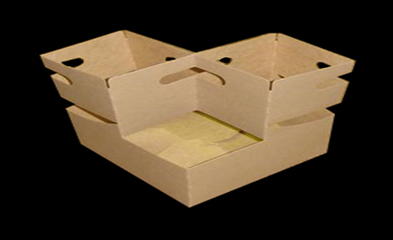
AUTOMATIC DRINK CARRIER
Description Size (in) Pack Weight Cube 4-Cup Drink Carrier up to 24oz 6-1/2 X 6-1/4 X 9 200 29.00 1.83 4-Cup Drink Carrier up to 32oz 7-1/4 X 7 X 9-1/4 200 34.00 2.06
(AVAILABLE IN PLAIN OR PRINTED)

Slide 8
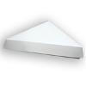
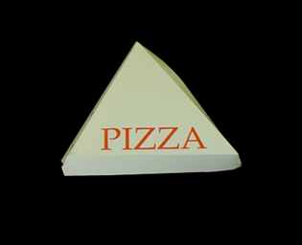
Pizza Box
PIZZA BOXES
STYLE- ONE PIECE CLAMSHELL
        (AVAILABLE PLAIN OR PRINTED)
PRODUCT CODE PROD. DESC. PACK/BDL BDL WEIGHT
942000 18-6 SINGLE(18”pizza slice 6 ways) 200 18

Slide 9

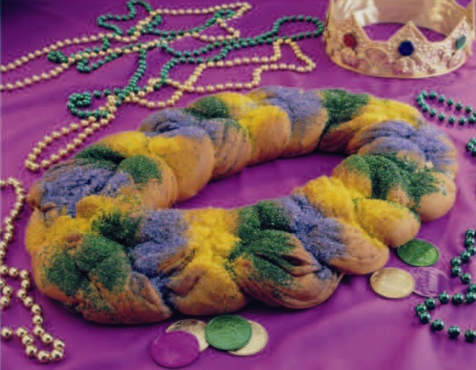
KING CAKE BOXES
Product # size case count weight
3487 small 5.5x5.5x2 500 35
2521 Med 14x10x3 100 32
3450 Large 17 7/8 x13x 3.5 50 30
All King cake boxes are printed in mardi gras colors

Slide 10
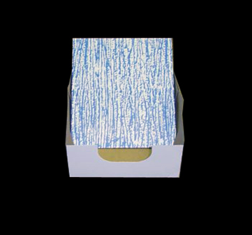
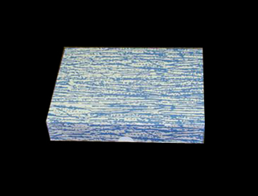
Letter Head Box
Product # size case count weight
1275 11 1/8 x 8 5/8 x 2 (set) 200 35
1276 14 1/8 x 8 5/8 x 2 (set) 200 35
1277 11 1/8 x 8 5/8 x 4 (set) 200 35
Letterhead boxes are available in plain or printed

